Slide 1
COS 212 Multiway Trees

Slide 2
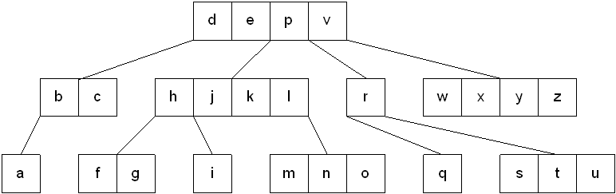
M-way trees
A multiway tree is a tree that can have more than two children
A multiway tree of order m (or an m-way tree) is one in which a tree can have a maximum of m children
How can we make such structures efficient/useful?
By introducing order that will allow to easily differentiate between the child branches
Let us define an m-way tree node as follows:
made up of m-1 key fields
m pointers to children
keys
pointers to children

Slide 3
M-way Search Trees
An m-way search tree is an m-way tree in which:
Each node has a maximum of m children and m-1 key fields
The keys in each node are stored in ascending order.
The keys in the first i children are smaller than the i-th key
The keys in the last m-i children are larger than the i-th key
keys
pointers to children

Slide 4
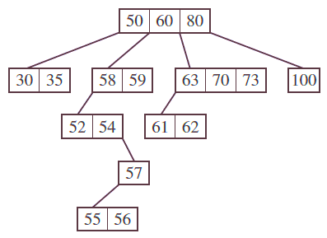
M-way Search Trees
Advantages of m-way search trees:
Same as with BST: efficient information storage and retrieval
From computer architecture perspective:
When a lot of data is processed, secondary storage such as hard drive memory must be used
Every time you traverse a tree, multiple data items have to be fetched and put back
Extremely inefficient! I/O read/write is very slow
Reality: you do not fetch a single data item; you fetch a memory block!
Idea: use the entire block every time!
If three keys fit into a block, construct a 4-way tree
If four keys fit into a block, construct a 5-way tree, etc.
Disadvantages?
Same as with BST: if it’s not balanced, you’re wasting your time!

Slide 5
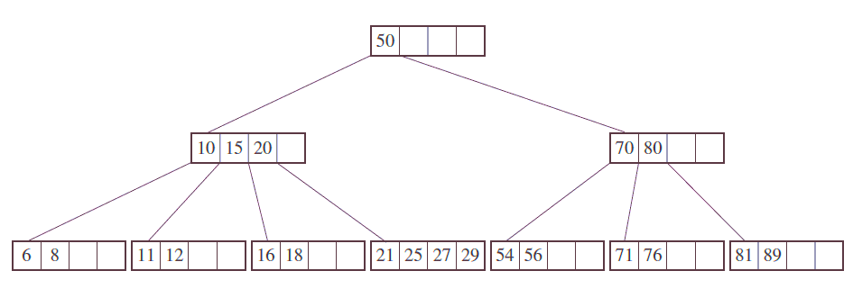

B-trees
A B-tree of order m is a multiway search tree in which:
The root has at least two subtrees unless it is the only node in the tree.
Each non-root and each non-leaf node has at most m non-empty children and at least m/2 (rounded up) non-empty children.
The number of keys in each non-root and each non-leaf node is one less than the number of its non-empty children.
Each leaf must contain at least ($\left\lceil \text{m}\text{/2}\right\rceil$ – 1) keys
All leaves are on the same level
These restrictions make B-trees always at least half full, have few levels, and remain perfectly balanced ☺

Slide 6
Implementing B-Trees
class BTreeNode<T extends Comparable<? super T>> {
boolean leaf = true; // leaf or non-leaf?
int keyTally = 1; // how many keys are used?
Comparable<T> keys[] = new Comparable[m-1];
BTreeNode<T> references[] = new BTreeNode[m];
BTreeNode(T key) {
keys[0] = key;
for (int i = 0; i < m; i++)
references[i] = null;
}
}
3 | F | 123 | 234 | 345 | / | / | /
 |  |  |  | / | / | /

Slide 7
B-Trees: Searching
Searching a b-tree for a value m:
Start at the root
Determine which pointer to follow based on a comparison between m and the keys
Follow the appropriate pointer to a child node, go to (2)
Continue till a key == m is found
Search for m = 27
Found!

Slide 8
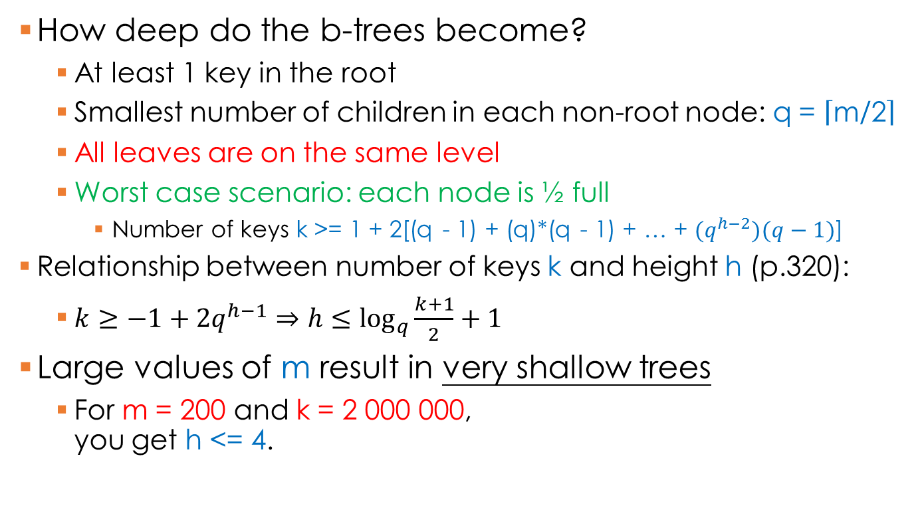
B-Trees: Searching
How deep do the b-trees become?
At least 1 key in the root
Smallest number of children in each non-root node: q = $\left\lceil \text{m}\text{/2}\right\rceil$
All leaves are on the same level
Worst case scenario: each node is ½ full
Number of keys k >= 1 + 2[(q - 1) + (q)*(q - 1) + … + $(q^{h−2})(q−1)$]
Relationship between number of keys k and height h (p.320):
$k≥−1+2q^{h−1}⇒h≤\log_{q}{\frac{k+1}{2}}+1$
Large values of m result in very shallow trees
For m = 200 and k = 2 000 000, you get h <= 4.

Slide 9
B-Trees: Insert
In a B-tree, all leaves must be on the same level
B-trees are not allowed to grow at the their leaves; instead they are forced to grow at the root
In a B-tree, a value is inserted directly into a leaf. This leads to three common scenarios:
A key is placed into a leaf that still has room
The leaf in which a key is to be placed is full
The root of the B-tree is full

Slide 10
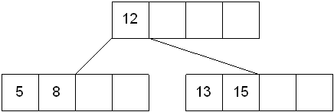
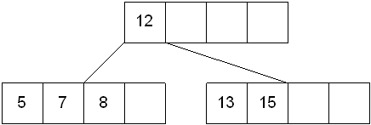
B-Trees: Insert
A key is placed into a leaf that still has room:
Find the leaf where the key belongs using B-tree search
Put the key in the correct place, shifting other keys as necessary
7

Slide 11
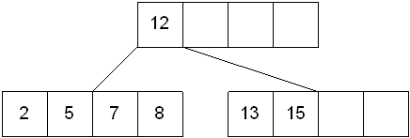
B-Trees: Insert
The leaf in which a key is to be placed is full
The leaf node where the key should be inserted is split in two, resulting in a new leaf node
Half of the keys are moved from the full leaf to the new leaf
The new leaf is incorporated by moving the middle value to the parent, and a pointer to the new leaf is also added to the parent
The process repeats up the tree until all keys are placed
6

Slide 12
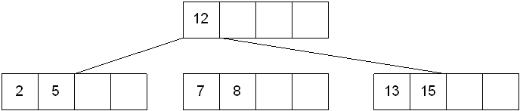
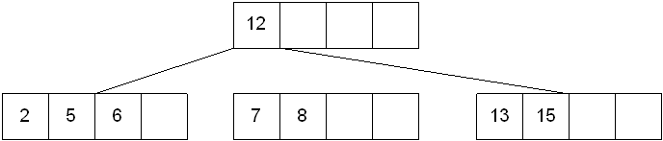
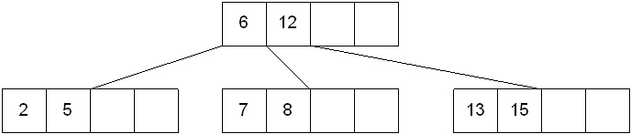
B-Trees: Insert
6

Slide 13
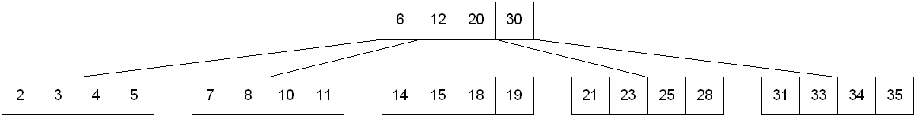
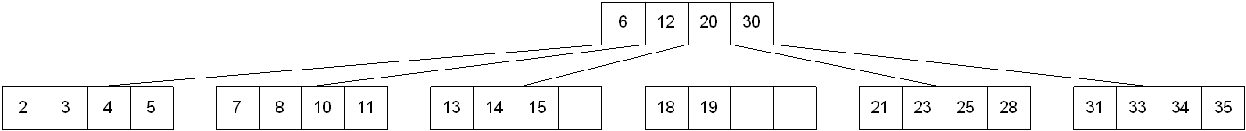
B-Trees: Insert
The root of the B-tree is full
Split root in two, creating two nodes
Half of the keys are moved from the root to the new node
New root is created by moving the middle value up and adding pointers to old root and the new node to the left and right of it
13
?

Slide 14
B-Trees: Insert
29
57
29
41
29
57
12
29
41
57
15
15
29
12
41
57
53
55
56
29
56
12 | 15
41
57
57
55
57

Slide 15
B-Trees: Insert
20
29
55
27
23
23
12 | 15
20
27
41 | 53
56 | 57
18
10
20
29
55
16
10
12
15
16
18
23 | 27
41 | 53
56 | 57
58
59
58
60
15 | 20
29
55
60
10 | 12
16 | 18
23 | 27
41 | 53
56 | 57
58
59

